Slide 1
Accession to EU, transposition of directives into national law
Petra Humlíčková
Arnika
September 2016

Slide 2
I. Legislative changes in Czech Republic
II. EU law
EU Enlargement
How EU laws are made
Have your say on EU law
Type of EU law
Application of EU law
Complaints
Infringements
Preliminary rulings
Basic facts on EU
III. Experiences of NGOs

Slide 3
Improving health and the environment
Pollution knows no borders – joint action needed
EU action has helped bring about:
cleaner bathing water
much less acid rain
lead-free petrol
easy and safe disposal of old electronic equipment
strict rules on food safety from farm to fork
more organic and quality farming
more effective health warnings on cigarettes
registration and control of all chemicals (REACH)

Slide 4
I. legislative changes - General Laws
173/1989 Coll. Ministry of Environment formed on 1 January 1990
282/1991 Coll. Act on the Czech Environmental Inspection and its jurisdiction in forest protection
388/1991 Coll. Czech National Council Act on the State Environmental Fund
17/1992 Coll. Environmental Act
All before accession to EU

Slide 5
 | Before EU | After EU
General Laws | Yes | No changes
Air | Yes | New
Water | Yes | New
Soil | Yes | Old (no directive)
Nature | Yes | Old (Natura 2000)
Aarhus Convention - EIA | Yes | New (EIA, information)
IPPC | No | New
Waste | Yes | New
Packaging | Yes | New
Mining | Yes | Old
Building | Yes | New (but not because EU)
Environmental Liability | Yes | New (use old ones)

Slide 6
legislative changes
Most new legislation in the period of 2-3 years before accession – time pressure
Best time to improve laws
Directive – only set goals (EIA, wastes)
More regulations (3.000 directives/100.000 pages)
Longer regulations
Amendment with the new directives/regulations

Slide 7
Article 11 EIA Directive
1. Member States shall ensure that, in accordance with the relevant national legal system, members of the public concerned:
a) having a sufficient interest, or alternatively;
b) maintaining the impairment of a right, where administrative procedural law of a Member State requires this as a precondition;
have access to a review procedure before a court of law or another independent and impartial body established by law to challenge the substantive or procedural legality of decisions, acts or omissions subject to the public participation provisions of this Directive.
2. Member States shall determine at what stage the decisions, acts or omissions may be challenged.
3. What constitutes a sufficient interest and impairment of a right shall be determined by the Member States, consistently with the objective of giving the public concerned wide access to justice. To that end, the interest of any non-governmental organisation meeting the requirements referred to in Article 1(2) shall be deemed sufficient for the purpose of point (a) of paragraph 1 of this Article. Such organisations shall also be deemed to have rights capable of being impaired for the purpose of point (b) of paragraph 1 of this Article.
4. The provisions of this Article shall not exclude the possibility of a preliminary review procedure before an administrative authority and shall not affect the requirement of exhaustion of administrative review procedures prior to recourse to judicial review procedures, where such a requirement exists under national law.
Any such procedure shall be fair, equitable, timely and not prohibitively expensive.
5. In order to further the effectiveness of the provisions of this Article, Member States shall ensure that practical information is made available to the public on access to administrative and judicial review procedures.

Slide 8
EU enlargement
52 – Fr+Ge+BeNeLux+It
73 – UK
81 – Greece
86 - Spain+Portugal
95 – Austria, Finland, Sweden
2004 – Malta, Cyprus, CR, SR, Est, Hu, Lat, Lit, Pol, Slovenia
2007 – Bulgaria+Romania
2013 - Croatia

Slide 9
Steps towards joining
Any European country + Copenhagen criteria (1993)
Respects principles of liberty, democracy, human rights+freedoms, rule of law
Stable democracy institution
Market economy
Cooperation, administration/legislation
DG Enlargement

Slide 10
Steps towards joining
West Balkans
Stabilising and transition to a market economy
Regional cooperation
Eventual membership of EU
Stabilisation and Association Agreements (SAAs) – before applying for membership

Slide 11
Steps towards joining
Candidate for membership
Formal membership negotiations
Unanimous decision by EU Council
EC opion on readiness
Screening
35 Chapters (rule of law, civil society, etc.)
Directly x benchmarkes
Negotiating positions
Closing chapters
Accession treaty
Transitional deadlines
EU Council, EC, EP, all MS, candidate country
Join EU

Slide 12
Steps towards joining Czech Republic
Candidate for membership - 1993
Formal membership negotiations - 1996
Negotiating positions - 1998
Closing chapters - 2002
Accession treaty - 2003
Join EU - 2004

Slide 13
How EU laws are made
Citizens, interest groups, experts: discuss, consult
Commission: makes formal proposal
Parliament and Council of Ministers: decide jointly
National or local authorities: implement
Commission and Court of Justice: monitor implementation

Slide 18
EU Law
Primary
Treaties (TFEU, TEU) are the basis or ground rules for all EU action
approved voluntarily and democratically by all EU member countries.
Treaty of Lisbon increased the number of policy areas where 'Ordinary Legislative Procedure' is used - EP also has more power to block a proposal if it disagrees with the Council
Secondary
regulations, directives, decisions, recommendations and opinions
Binding x non-binding
apply to all EU countries x to just a few
are derived from the principles and objectives set out in the treaties

Slide 19
EU Law – find law

Slide 20
EU Law – find case law

Slide 21
EU Law – find case law

Slide 22
EU Law – find case law

Slide 23
Have your say on EU policies
European Citizens' Initiative
Ask the European Commission to propose legislation on an issue you care about – through an ECI.
To show it has widespread support, your initiative will need to be signed by a million EU citizens, from at least a quarter of EU member countries (7 out of the 28).

Slide 24
Have your say on EU policies
Public consultations
When the Commission starts working on a new policy initiative or revises existing legislation, it usually opens a public consultation.
Individuals, businesses and other organisations with an interest in or expert knowledge on a given topic can help shape the Commission's draft proposal before it goes to the Council and European Parliament for discussion and adoption.
Your Voice in Europe

Slide 25
Have your say on EU policies
Citizen's Dialogue
Citizens' Dialogues are held in cities across the EU, to listen to people’s views and discuss issues people are concerned about.
Petitions to the European Parliament
EU citizens and residents, as well as companies and other organisations headquartered in the EU may petition Parliament on issues related to EU policy that affect them directly.
Commission at Work – Notifications and Transparency Register
To be notified by e-mail of new roadmaps and/or public consultations, subscribe to Commission at Work – Notifications.
If you represent an organization or you are a self-employed individual involved in activities that influence the EU institutions' policymaking and decision-making processes, subscribe to the EU Transparency Register.

Slide 26
EU Law – types of Secondary Laws
Regulations
A "regulation" is a binding legislative act
It must be applied in its entirety across the EU
National level – procedural rights
Fisheries, chemicals, ozon layer, CITES

Slide 27
EU Law – types of Secondary Laws
Directives
A "directive" is a legislative act that sets out a goal that all EU countries must achieve.
However, it is up to the individual countries to devise their own laws on how to reach these goals.
Water Framework Directive, EIA, Waste Framework Directive, Clean Air Directive

Slide 28
EU Law – types of Secondary Laws
Decisions
A "decision" is binding on those to whom it is addressed (e.g. an EU country or an individual company) and is directly applicable.
Recommendations
A "recommendation" is not binding. When the Commission issued a recommendation, this did not have any legal consequences.
A recommendation allows the institutions to make their views known and to suggest a line of action without imposing any legal obligation on those to whom it is addressed.
Opinions
An "opinion" is an instrument that allows the institutions to make a statement in a non-binding fashion, in other words without imposing any legal obligation on those to whom it is addressed.
An opinion is not binding.
It can be issued by the main EU institutions (Commission, Council, Parliament), the Committee of the Regions and the European Economic and Social Committee.
While laws are being made, the committees give opinions from their specific regional or economic and social viewpoint. For example, the Committee of the Regions issued an opinion on the clean air policy package for Europe.

Slide 29
Application of EU law
EU law - which has equal force with national law - confers rights and obligations on the authorities in each member country, as well as individuals and businesses.
The authorities in each member country are responsible for implementing EU legislation in national law and enforcing it correctly and timely, and they must guarantee citizens’ rights under these laws.
European Commission acts as a Guardian of the Treaty (TFEU) and oversees the application of EU law under the supervision of the Court of Justice of the European Union.

Slide 30
Application of EU law
Complaint - infringement procedure
Infringement procedure
Preliminary ruling

Slide 31
Making a complaint
EC confirm to you that it has received your complaint within 15 working days.
Within the following 12 months, EC will assess your complaint and aim to decide whether to initiate the formal infringement procedure against the Member State in question.
If the issue that you raise is especially complicated, or if the European Commission needs to ask you or others for more information or details, it may take longer than 12 months to reach a decision.
If the European Commission decides that your complaint is founded and initiates the formal infringement procedure against the Member State in question, it will inform you and let you know how the case progresses.
If the European Commission thinks that your problem could be solved more effectively by any of the available informal or out-of-court problem-solving services, it may propose to you that your file be transferred to those services.
If the Commission decides your problem does not involve a breach of Union law, it will inform you by letter before it closes your file.
At any time, you may give the European Commission additional material about your complaint or ask to meet representatives of the European Commission.
EC disreation
Compensation national courts

Slide 32
Making a complaint
use the standard complaint form
Any official EU language
how national authorities have infringed Union law
which is the Union law that have been infringed
Give details of any steps you have already taken to obtain redress.
via internet: online complaint form
by post: European Commission Secretary-General B-1049 Brussels BELGIUM

Slide 33
Making a complaint

Slide 35
Infringement procedure
EC against an EU country that fails to implement EU law.
EC may refer the issue to the Court of Justice, which in certain cases, can impose financial penalties.
EC identifies possible infringements of EU law on:
the basis of its own investigations
following complaints from citizens, businesses or other stakeholders.
Early settlement
EC first tries to solve the problem informally with the EU country concerned. The EU country can provide factual and/or legal information on the potential violation of EU law.
The goal is to find a quick solution in compliance with EU law and avoid the need for a formal infringement procedure.

Slide 36
Infringement procedure
Formal procedure
If the EU country concerned fails to communicate measures that fully transpose the provisions of directives, or doesn’t rectify the suspected violation of EU law, the Commission may launch a formal infringement procedure. The procedure follows a number of steps laid out in the EU treaties, each ending with a formal decision:
The Commission sends a letter of formal notice requesting further information to the country concerned, which must send a detailed reply within a specified period, usually 2 months.
If the Commission concludes that the country is failing to fulfil its obligations under EU law, it may send a reasoned opinion: a formal request to comply with EU law. It explains why the Commission considers that the country is breaching EU law. It also requests that the EU country inform the Commission of the measures taken, within a specified period, usually 2 months.
If the EU country still doesn't comply, the Commission may decide to refer the matter to the Court of Justice. Most cases are settled before being referred to the Court.
If an EU county fails to communicate measures that implement the provisions of a directive in time, the Commission may ask the Court to impose penalties.
If the Court finds that a country has breached EU law, the national authorities must take action to comply with the Court judgment.

Slide 37
Infringement procedure
Non-compliance with a Court decision
If, despite the Court's judgment, the EU country still doesn't rectify the situation, the Commission may refer the country back to the Court.
Financial penalties
When referring an EU country to the Court for the second time, the Commission proposes that the Court impose financial penalties, which can be either a lump sum and/or a daily payment.
These penalties are calculated taking into account:
the importance of the rules breached and the impact of the infringement on general and particular interests
the period the EU law has not been applied
the country's ability to pay, ensuring that the fines have a deterrent effect
The amount proposed by the Commission can be changed by the Court in its ruling.
Publication of infringement decisions
Before non public

Slide 38
Infringement procedure

Slide 39
Infringement procedure

Slide 40
preliminary ruling
before the Court of Justice of the European Union (CJEU)
This procedure is open to all Member States’ national judges. They may refer a case already underway to the Court in order to question it on the interpretation or validity of European law.
In contrast to other judicial procedures, the reference of a preliminary ruling is therefore not a recourse taken against a European or national act, but a question presented on the application of European law.
The reference for a preliminary ruling thus promotes active cooperation between the national courts and the Court of Justice and the uniform application of European law throughout the EU.
Non binding recommendations (2012)

Slide 41
preliminary ruling
Any national court to which a dispute in which the application of a rule of European law raises questions (original case) has been submitted can decide to refer to the Court of Justice to resolve these questions. There are two types of reference for a preliminary ruling:
a reference for a ruling on the interpretation of the European instrument (primary law and secondary law): the national judge requests the Court of Justice to clarify a point of interpretation of European law in order to be able to apply it correctly;
a reference for a preliminary ruling on the validity of a European instrument of secondary law: the national judge requests the Court of Justice to check the validity of an act of European law.
The reference for a preliminary ruling is therefore a reference from one judge to another. Although a referral to the Court of Justice may be requested by one of the parties involved in the dispute, the decision to do so rests with the national court.
National courts which act as a final resort, against whose decisions there is no judicial remedy, are obliged to make a reference to the Court of Justice for a preliminary ruling, unless the Court has already ruled on the matter or the interpretation of the EU rule of law in question is obvious.
In contrast, national courts which do not rule in final resort are not obliged to exercise the reference for a preliminary ruling, even if one of the parties requests it.
In any case, all national courts must immediately refer a matter to the Court of Justice in cases of doubt regarding the interpretation of a European provision. However, they must submit to the Court a reference for a preliminary ruling when they have doubts regarding the validity of an act issued by a Union institution, body, office or agency.
The Court of Justice only gives a decision on the constituent elements of the reference for a preliminary ruling made to it. The national court therefore remains competent for the original case.
On principle, the Court of Justice must answer the question put to it. It cannot refuse to answer on the grounds that this response would be neither relevant nor timely as regards the original case. It can, however, refuse if the question does not fall within its competence.

Slide 42
preliminary ruling
Effects of the reference for a preliminary ruling on national proceedings
The submission of a reference for a preliminary ruling calls for national proceedings to be stayed until the Court has given its ruling.
General scope of preliminary rulings
The Court of Justice Decision has the force of res judicata. It is binding not only on the national court on whose initiative the reference for a preliminary ruling was made but also on all of the national courts of the Member States.
In the context of a reference for a preliminary ruling concerning validity, if the European instrument is declared invalid all of the instruments adopted based on it are also invalid. It then falls to the competent European institutions to adopt a new instrument to rectify the situation.

Slide 43
preliminary ruling - Example
Article 9(3) of the Convention on access to information, public participation in decision-making and access to justice in environmental matters approved on behalf of the European Community by Council Decision 2005/370/EC of 17 February 2005 does not have direct effect in European Union law. It is, however, for the referring court to interpret, to the fullest extent possible, the procedural rules relating to the conditions to be met in order to bring administrative or judicial proceedings in accordance with the objectives of Article 9(3) of that convention and the objective of effective judicial protection of the rights conferred by European Union law, in order to enable an environmental protection organisation, such as the Lesoochranárske zoskupenie, to challenge before a court a decision taken following administrative proceedings liable to be contrary to European Union environmental law.
(C‑240/09)

Slide 44
CJEU and you
If you – as a private individual or as a company – have suffered damage as a result of action or inaction by an EU institution or its staff, you can take action against them in the Court, in one of 2 ways:
indirectly through national courts (which may decide to refer the case to the Court of Justice)
directly before the General Court – if a decision by an EU institution has affected you directly and individually x never in environmental cases x ACCC

Slide 45
EU basic facts

Slide 46
The EU institutions
European Council (summit)
European Parliament
Council of Ministers
(The Council)
European Commission
Court of Justice
Court of Auditors
Economic and Social Committee
Committee of the Regions
European Investment Bank
Agencies
European Central Bank

Slide 47
Three key players key players
The European Parliament
- voice of the people
Martin Schulz, President of the European Parliament
The European Council and the Council
- voice of the Member States
Donald Tusk, President of the European Council
The European Commission
- promoting the common interest
Jean-Claude Juncker, President of the European Commission

Slide 48
The European Parliament – voice of the people
Decides EU laws and budget together with the Council of Ministers
Democratic supervision of all the EU’s work
Number of members elected in each country
Austria - 18
Belgium - 21
Bulgaria - 17
Croatia - 11
Cyprus - 6
Czech Republic - 21
Denmark - 13
Estonia - 6
Finland - 13
France - 74
Germany - 96
Greece - 21
Hungary - 21
Ireland - 11
Italy - 73
Latvia - 8
Lithuania - 11
Luxembourg - 6
Malta - 6
Netherlands - 26
Poland - 51
Portugal - 21
Romania - 32
Slovakia - 13
Slovenia - 8
Spain - 54
Sweden - 20
United Kingdom - 73
Total - 751

Slide 49
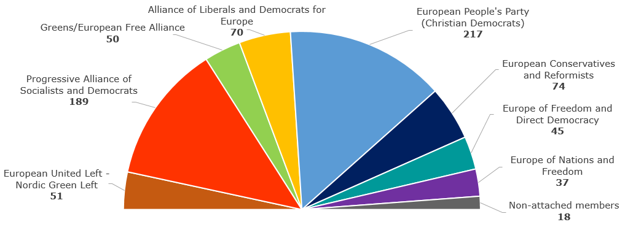
The European political parties
Number of seats in the European Parliament per political group (July 2015)
Total: 751

Slide 50
Council of Ministers – voice of the Member States
One minister from each EU country
Presidency: rotates every six months
Decides EU laws and budget together with Parliament
Manages the common foreign and security policy

Slide 51
Council of Ministers – how they vote
Most decisions in the Council are taken by ‘double majority’.
A decision must have the support of at least:
• 55 % of Member States (16 countries)
• Member States that represent 65 % of the EU’s population

Slide 52
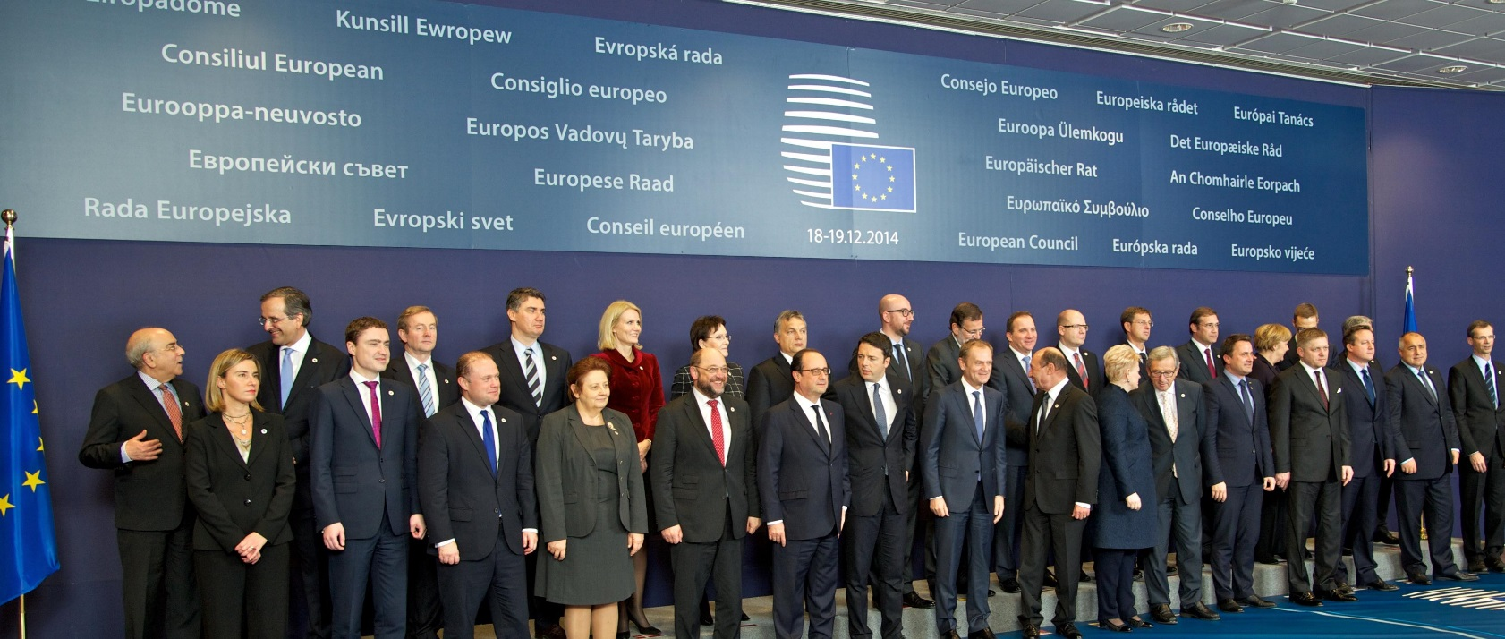
Summit at the European Council
Summit of heads of state and government of all EU countries
Held at least 4 times a year
Sets the overall guidelines for EU policies
President: Donald Tusk

Slide 53
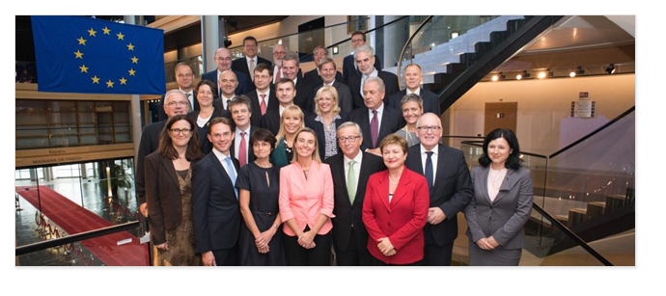
The European Commission – promoting the common interest
28 independent members, one from each EU country
Proposes new legislation
Executive organ
Guardian of the treaties
Represents the EU on the international stage

Slide 54
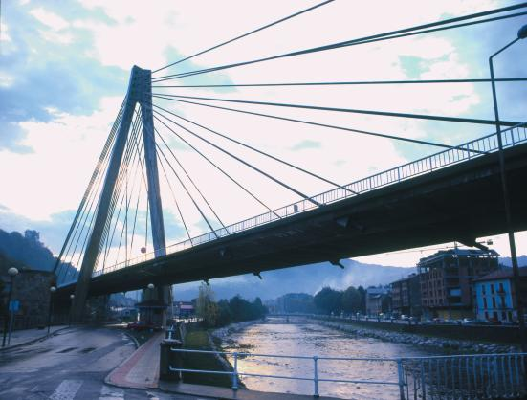
The Committee of the Regions: voice of local government
353 members
Represents cities and regions
Advises on new EU laws and policies
Promotes the involvement of local government in EU matters

Slide 55
The Court of Justice – upholding the law
28 independent judges, one from each EU country
Rules on how to interpret EU law
Ensures EU countries apply EU laws in the same way

Slide 56
Getting in touch with the EU
Questions about the EU? Europe Direct can help
By phone, email or webchat
Over 500 regional information centres
europa.eu/europedirect

Slide 57
III. Experiences of NGOs
For x against accession
Reasons, partners
Information campaigns
For NGOs
For wide public
EU/EU actualities/lobbying/content of directives
Monitoring of MEP
Accession procedure
Each year – reports on each chapter
Information from MoE (negotiators)
Networking
EU NGOs/NGOs from EU MS

Slide 58
III. Experiences of NGOs
Capacity building
Seminars, conference (e.g. EEB)
Model solutions
„New“ national campaigns
Fulfill EU law
Part of EU campaings
petitions, lobbying of MEP, citizen initiative, your voice in europe
Model solutions
Lack of time
Hard to change
Verify suitability (corruption effect, etc)
EU funds
Support for NGOs
Effective envi protection
EU law enforcement

Slide 59
Thank you for your attention!

