Slide 1
Public participation Case studies
Petra Humlickova
Arnika
September 2016

Slide 3
Main findings
Lack of communication/information
Fear of decreasing environment/characteristics of community
Right to participate – abuse of participation – suggestions to abolish right to participate
Public can not decide, just control
Longer procedures + lower economic growth – reasons? Slow courts, administrative bodies
Public – experts + local knowledge – better sollutions

Slide 4
Supermarket in Park (skuteč)
Supermarket in park (noise, lost of recreation place)
Establish NGO
Challenge (administrative/court) administrative decision
Developer start to offer financial compensation
NGO denied compensation
New developer – supermarket outside city (better location)

Slide 5
hazardous waste incineration plant
Renovation
Since 2006 still not finished
Petition (almost 50.000 signatures)
EIA more than 5000 (public hearing)
Developer offer to sell it to regional government

Slide 6
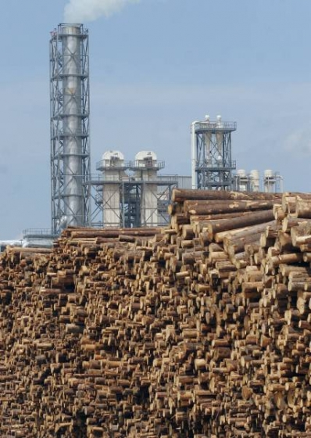
Existing factory
Existing factory – health problems – no information
Renovation of factory - new EIA – hunderds of citizens, NGOs – effective condition in EIA (monitoring of emission)
Controll fulfillment of EIA conditions in follow-up procedures
Improvement of factory

Slide 7
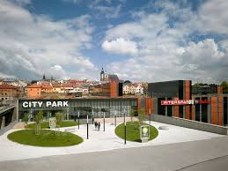
Supermarket close to historic city center (Jihlava)
Historical city center x classical shopping center
Hunderds of citizens, NGOs, petitions
Lot of conditions (park, river, new trails)
Conditions changed during building of shopping center

Slide 8
Housing instead of park
Developer – build in traditional historical park in Prague (Kotlářka)
Agreement of NGO + municipality + developer
Public park
Housing only close to park (not inside)
No challenges of public
Breach by developer (gardens of houses in park), municipality (no care about public park)
Activities of NGO
Experts opinions (ecological status of park)
Increase knowledge of house owners (not to damage park)
Challenge administrative decisions
Take care of public park

Slide 9
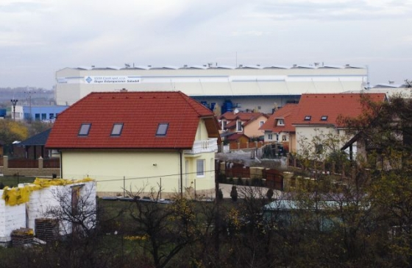
Factory in city (Úvaly u Prahy)
Noise, vibration whole day/night
Close to housing
No EIA, no information to public – do not participate (building of factory and housing in same time)
No successful challenge of administrative act
Only success – not make bigger

Slide 10
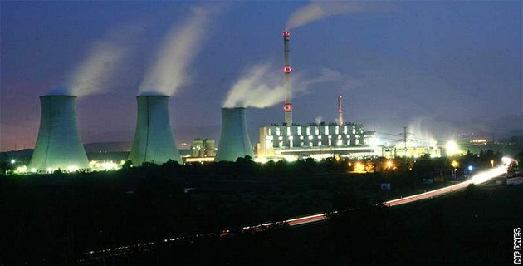
Coal power plant
Maintanence x new power plant – different limits of energy efficiency
EIA participation of Micronesia (climate change)

Slide 11
Reccomendation
Start early
Control whole procedure till end
Set goals (what do you want?)
Build coalition (NGO, municipality, citizens)
Stay together
Get funding
Expert opinions

