Slide 1
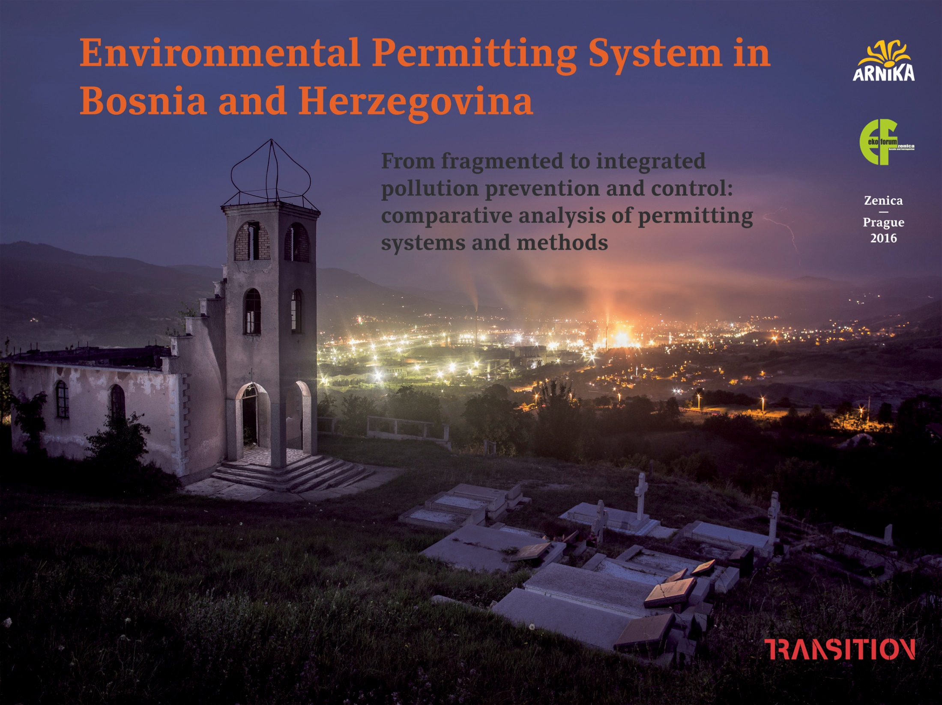

Slide 2
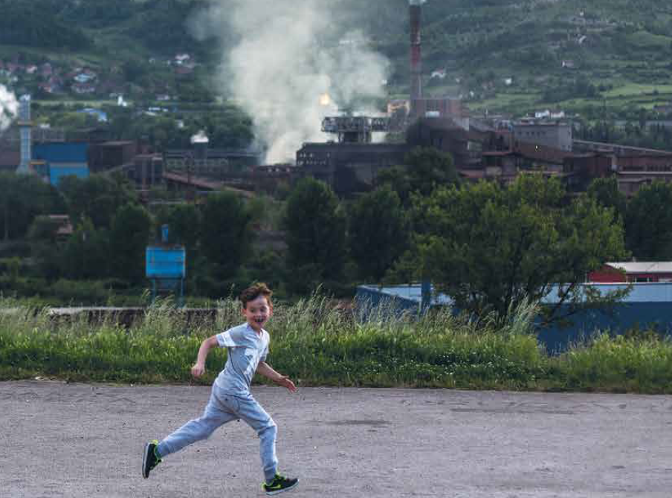
Permitted pollution?
Today: export of electricity, steel
Since Yugoslavia: heavy industry
The most polluted air in Europe
Are BiH law regulations effective?
Can the EU regulations help?

Slide 3
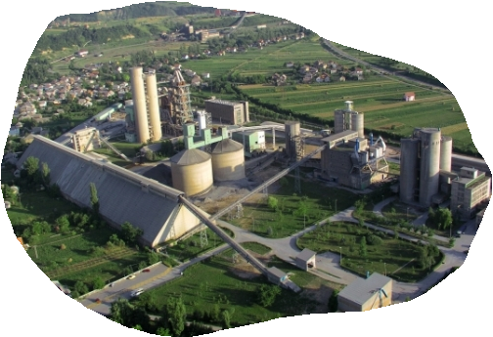
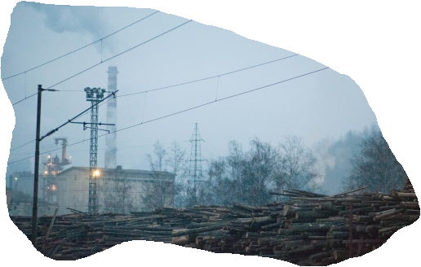
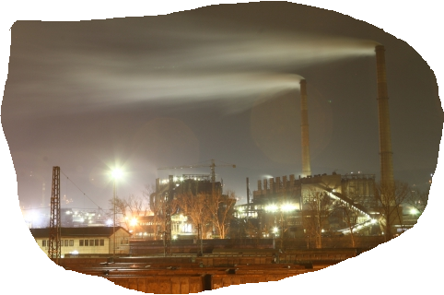
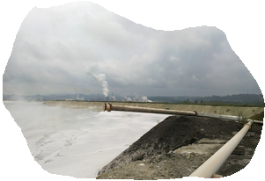
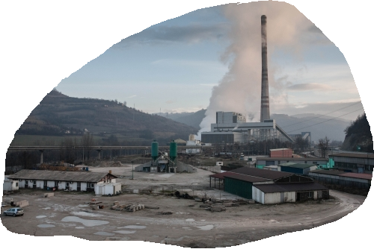
BiH: environmetnal pollution
metallurgy
coal power plants
cement production
chemical industry
coal power plants

Slide 4
BiH: environmental policy
No nationwide environmental policy exists: Entities have different legislation and regulations
2008: European Partnership Agreement called for the adoption of a State-level Law on Environmental Protection (still pending)
2015: National Emission Reduction Plan of BiH: budget of BAM 640 million (€320,000,000), calls for the reduction of harmful emissions in large combustion facilities to comport with the EU by 2027
Permitting system of industrial facilities is fragmented and complex.
Because of fragmented policy, the EU is not releasing further funds from the Community Assistance, Development and Stabilization (CARDS) programme and the Instrument for Pre-Accession Assistance (IPA).

Slide 5
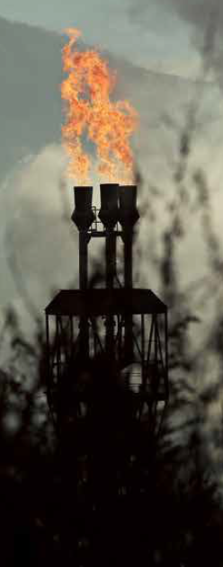
From fragmented to integrated ap
integrated permit
water
air
soil
nature
waste

Slide 6
EU: integrated permitting
1982 – 2010: four environmental action programmes identified the need to shif from fragmented to integrated system
1985: Environmental Impact Asssesment (EIA) Directive introduced holistic approach
1996: Integrated Pollution Prevention and Control (IPPC) Directive
2010: Industrial Emissions Directive
Integrated permitting is more than just a “stapling together” of single-media permits. It addresses each aspect of a facility’s operation that has environmental impact and comprises pollution prevention, effects, and interactions of various environmental media, facility management systems, and long-term sustainability.

Slide 7
Advantages of integrated system
❶ Better overall solution
Fragmented approach may have a spillover effect. Comprehesive review helps control the overall environmental impact of production processes.
❷ Efficiency
Consolidating multiple permits and overlapping processes into a single permit reduces administrative costs, for both regulatory agencies and regulated facilities.
❸ Pollution prevention
Integrated facility assessment is more likely to promote pollution prevention than simply imposing “end-of-pipe” controls.
❹ Sustainability
Integrated permits address operational aspects (e. g. natural resource use, generation and recovery of waste, and habitat impact) – they promote long-term sustainability.
❺ Public participation
Broad, facility-wide assessment of environmental impacts makes public participation easier (no need to participate in several separate and time-consuming processes).

Slide 8
IPPC: technologies and environment
BEST: means most effective in achieving a high general level of protection of the environment as a whole
AVAILABLE: means those developed on a scale which allows implementation in the relevant industrial sector, under economically and technically viable conditions, taking into consideration the costs and advantages, whether or not the techniques are used or produced inside the Member State in question, as long as they are reasonably accessible to the operator
TECHNIQUE: includes both the technology used and the way in which the installation is designed, built, maintained, operated and decommissioned
best
available
technique

Slide 9
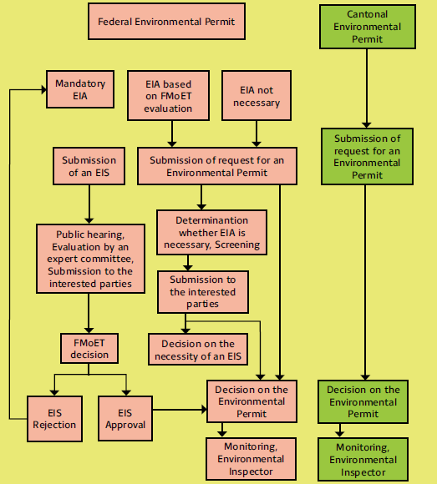
BiH: environmental permitting
Virtually identical entitity level laws for FBiH and RS
Disintegrated approach
Relatively low treshold limits (Cantons can permit also facilities below them)
Unusual centralised approach
Permits issued for 5 years

Slide 10
BiH: main issues
Disintegration
  Expensive, confusing, time consuming process, adminstrative burden
Centralisation
  Ministries are far from factories and do not know local specifics
Lack of expertise
  Ministries have no capacity to assess highly technical matters
Deadlines
  Authorities illegaly prolongue deadlines for administrative decision (60 - 120 days) – delay of 600 days was recorded
Emission values
  BAT adopted only for food industry, BREF not translated
Public participation
  Ministries are far from factories and do not know local specifics
Lack of control
  Sanctions for violation of the conditions are only symbolic
Data on pollution
  Publicly available Pollution Release Inventory does not exist
Environmental permits
  Issued permits are not publicly available (no on-line tool)

Slide 11
EU inspiration
Ireland (1992)
Czech Republic (2002)
Croatia (2008)

Slide 12
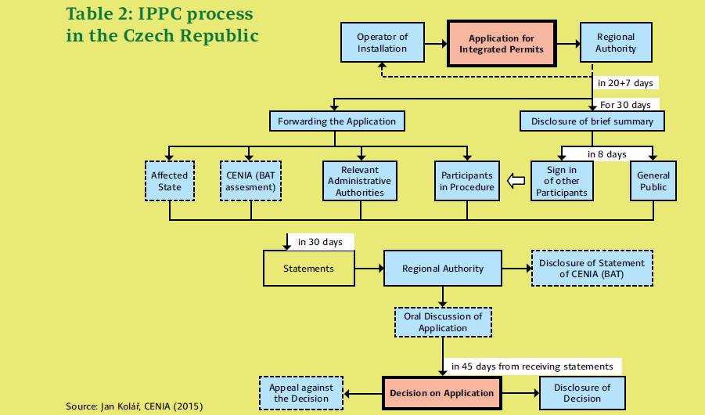
IPPC in Czech Republic

Slide 13
Czech IPPC: key aspects
integrated permitting
regional environmetnal agencies
best available techniques
strong environmental inspectorate
expert body of ministry of environment

Slide 14
Czech system: few figures
300 controls annually
fines 70,000 - 350,000 euro
1,708 facilities publish data on pollution on-line
1,708 facilities need integrated permit

Slide 15
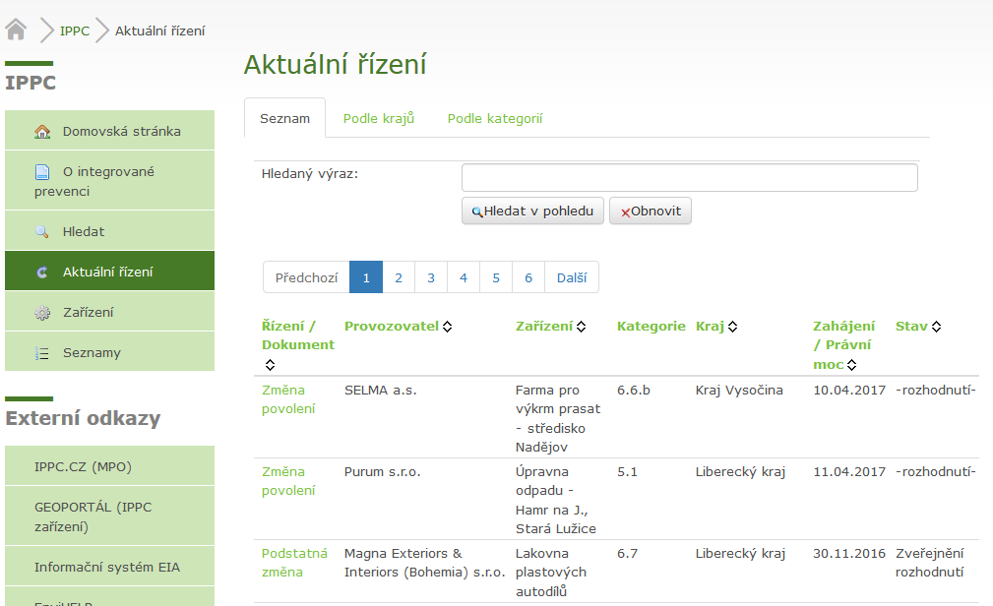
Czech IPPC: on-line database

Slide 16
CZ: sucessfull stories
Kronospan (chipboard)
PRI showed emissions: 474 t of dust & 22 t of formaldehyde
Outdated technology: different than in Austria
Spolana (chemical production)
Dangerous chlorine production, numerous accidents
Hamburg pays 70,000,000 EUR annualy for mercury clean-up
Trinec Iron and Steel Works
Investment 100,000,000 EUR to reduce dust emissions by 1/3
PRI helped the factory save their resources (and money)
Public enforced permit for no-formaldehyde production
Integrated permit issud for no-mercury production
EU legislation imposed strict requiremens

Slide 17
BiH: adopting international standards
2003: Some requirements of IPPC Directive covered by FBiH and RS Laws on Environmental Protection
2008: Aarhus Convention on access to infomation, public participation in decision making nad right for independent court review
2008 (2015): Stabilisation and Association Agreement with the EU on harmonization of the legislation
2016: EU funded project to implement Industrial Emissions Directive
2009: EU funded project to establish Pollution Release Inventory failed (1,199,825 euro spent)
EU pollution limits should be reached only in 2021
Lack of environmental aspects in international agreements (Energy Treaty)

Slide 18
BiH: recent cases
Tuzla Thermal Power Plant
No desulphurisation filters (50,000 tons of SO₂ annually)
New permists issues although limits exceeded
Banovici thermal power plant
Environmental permit set no emission limits
Appelate mechanism dysfunctional
ArcelorMittal streelworks in Zenica
Operating 3 years without environmental permits
New permits allow exceeding emission limits
Lukavac rubber processing plant
Ministry permitted new dirty plant despite public opposition
Authorities did not know how to deal with illegal plant

Slide 19
Recommendations
❶ Adoption of IPPC Act
Identical laws implementing the EU Industrial Emission Directive should be adopted both in FBiH and RS
❷ Translation of BAT/BREF
BAT/BREF documents have to be available in official languages – they are essential for issuing integrated permits and setting the limits
❸ Pollution Release Inventory
On-line database of industrial pollution data should be publicly availabe, covering both FBiH and RS
❹ Strong Institutions
Probably new expert authority will have to be established, environmental inspectorates strenghten and fines increased
❺ Accessible permits
Issued and valid integrated (environmental) permits should be publicly availabe at on-line database

Slide 20



more information:
www.eko.ba
www.english.arnika.org/bosnia-and-herzegovina

