Slide 1
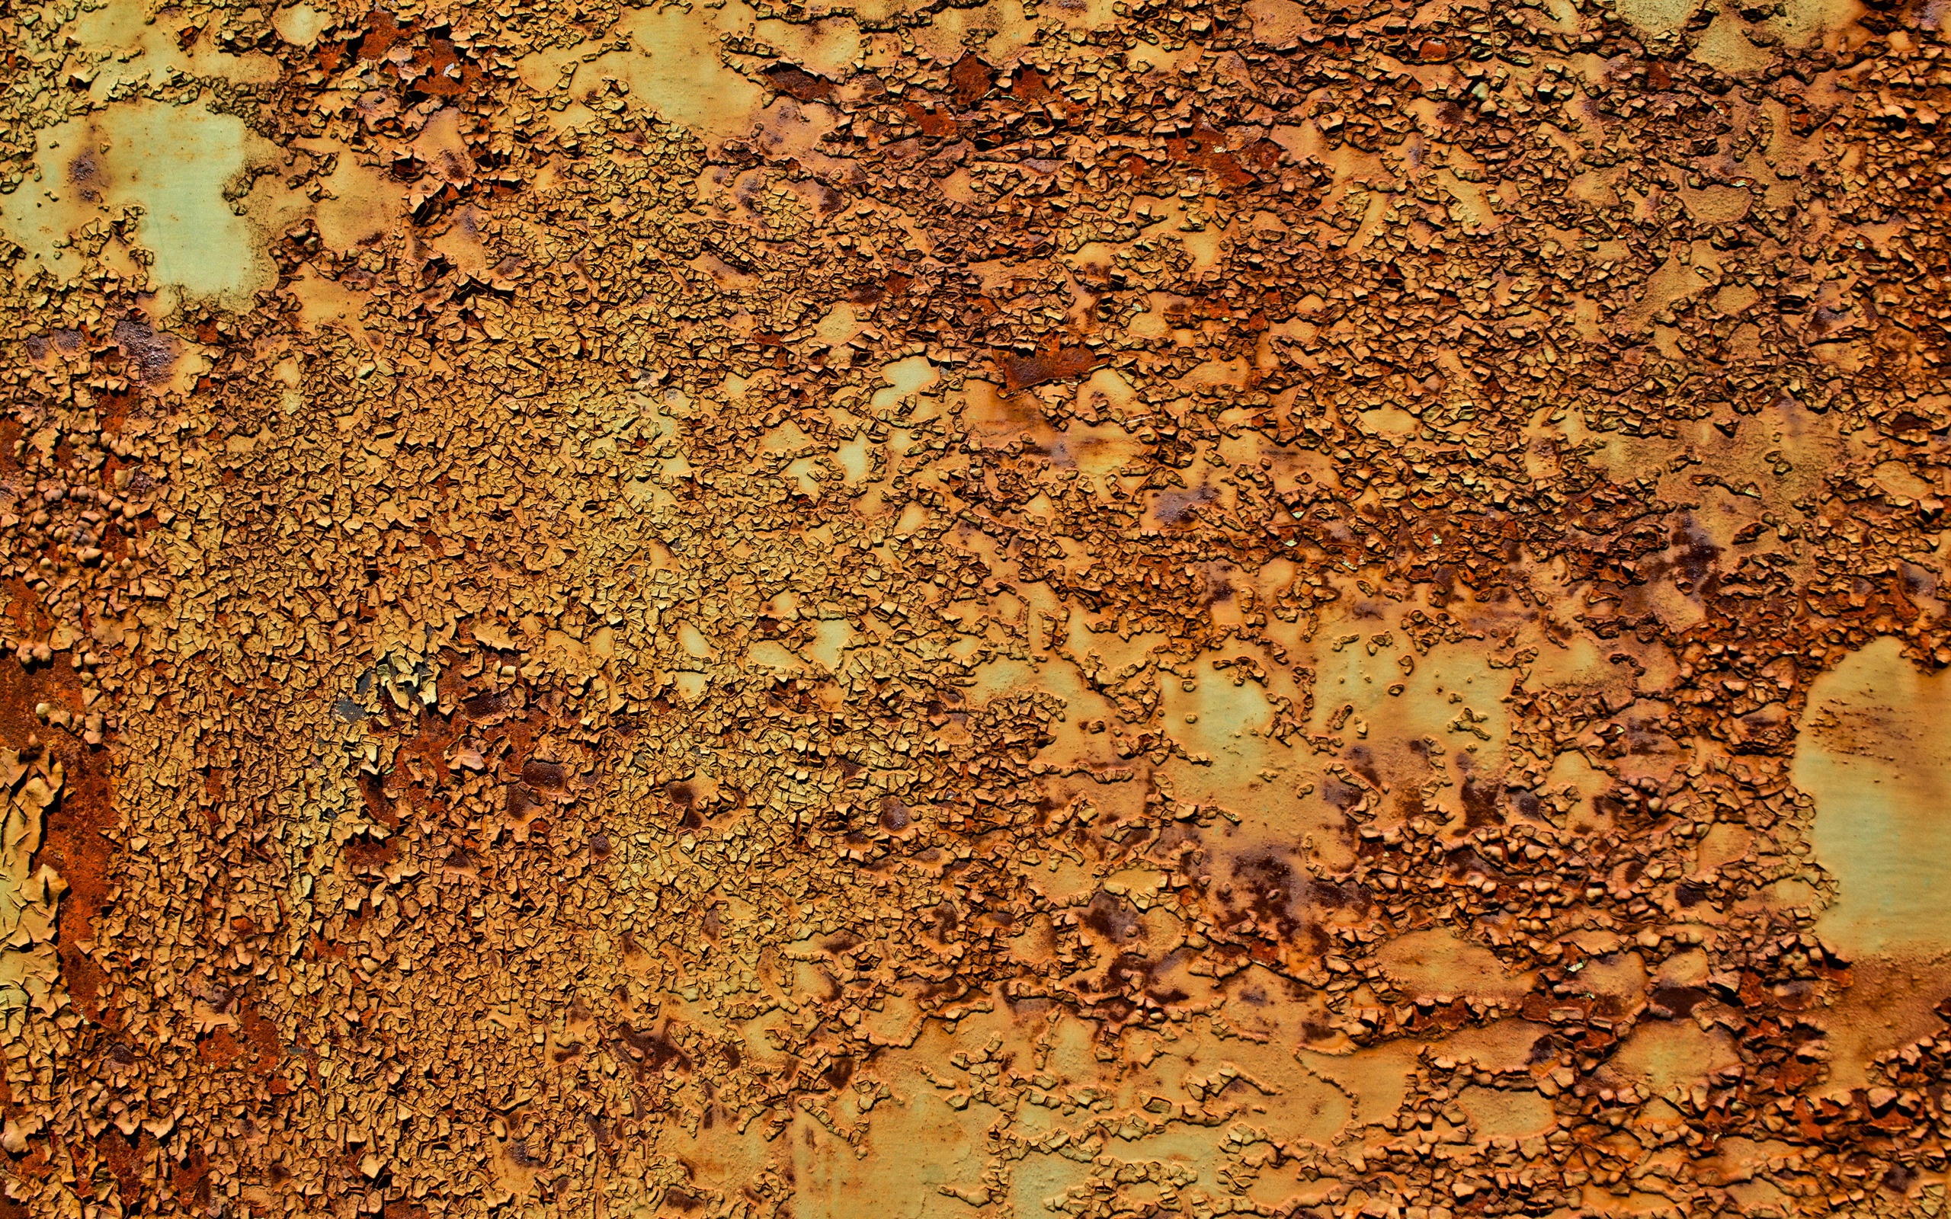
ArcelorMittal Zenica
Samir Lemeš
Eko forum
To what extent is the new environmental permit for ArcelorMittal Zenica really integral?

Slide 2

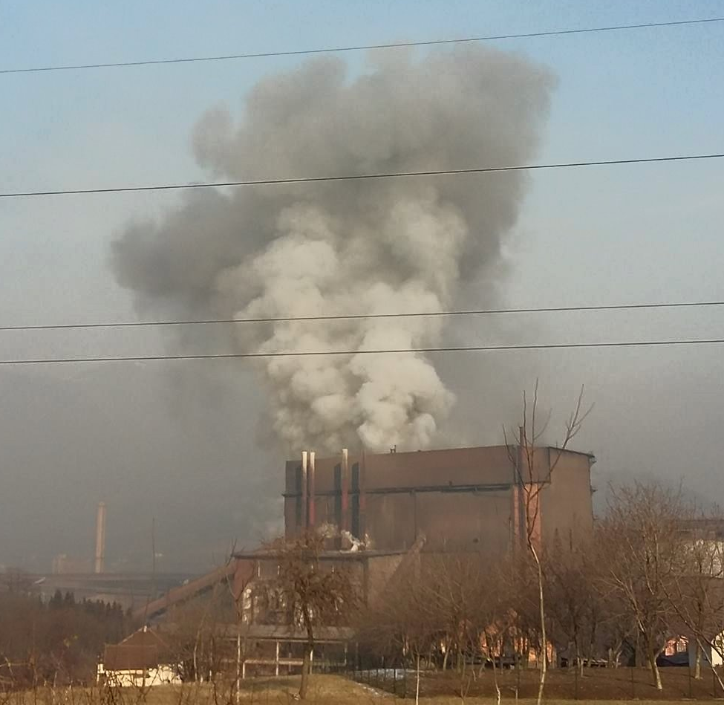
ArcelorMittal Zenica
Steelworks before privatization and before
Federal Environment Protection Act
Privatizations and plan of activities for first environmental permits
Why permits didn't gave results?
Permit for BOF renewed against the law?
Request for the "integral" permit
CSO assisted permit renewal process
The struggle never ends

Slide 3
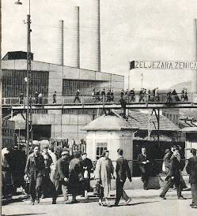
Steelworks before privatization and Environment Protection Act
In 1892, Austro-Hungarian enterpreneurs started
iron/steel production in Zenica.
After WW2, socialist government decided to
expand the production, using Russian technology.
Until 1990's: 20,000+ employees,
producing 3,000,000 tons of iron/steel annualy.
In 1960's first environmental activities
In 1992 production completely stopped
In 2003: Federal EPA adopted – introduction of environmental permits

Slide 4
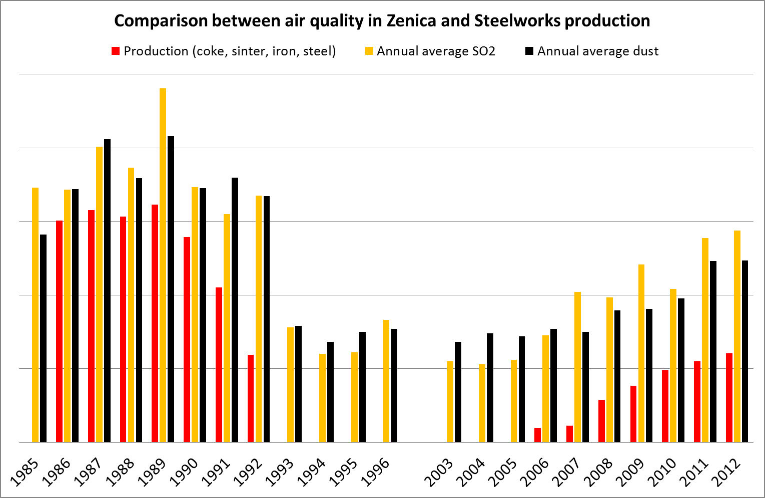
Privatizations and plan of activities for first environmental permits
In 1999 acquired by Kuwait Investment Agency (KIA)
In 2004, Mittal acquires 92% shares from KIA and Bosnian government.
In 2008, integral steel production restarted:
Sintering Plant, Coke Oven, Blast Furnace,
Power Plant, BOF, Forging Plant, Rolling Mill.
Air pollution starts to increase again;
concentrations follow production rate.
Privatization agreement was never disclosed.
Existing installation – plan of activities
prepared by local university

Slide 5
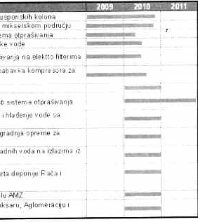
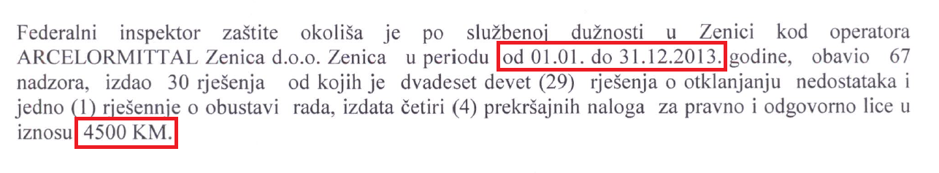
Why permits didn't gave results?
Permits issued with 2-3 years delay
(excuse: lack of expertise?!)
Expert opinions ignored in public hearing phase (no excuse)
Penalties symbolic and too low
No cadastre of polluters
(blame the households, traffic,...)
Financial crisis, recession, market price and steel demand drop,...
Choosing the cheapest contractors
Deadlines breached for years

Slide 6
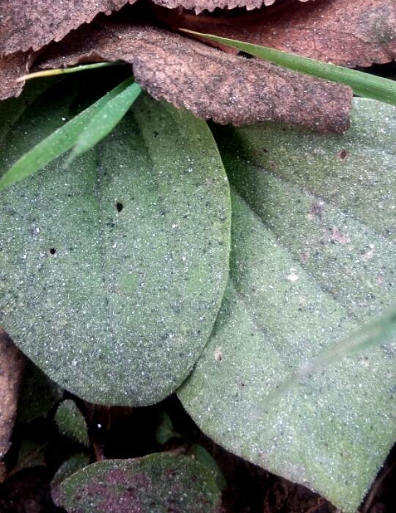
Permit for BOF renewed against the law?
The first permits expired in December 2014
ArcelorMittal requested renewal only for BOF (converter furnace)
EIA requested only for the new installations?!?
Public participation disabled in renewal process?!?
No penalties for delayed or unfinished projects
Limit emission values higher in permit than in BiH regulations
Meetings, letters, complaints, media pressure,...
Litigation by CSO and the City (December 2015) –
in June 2017 still no court decision

Slide 7
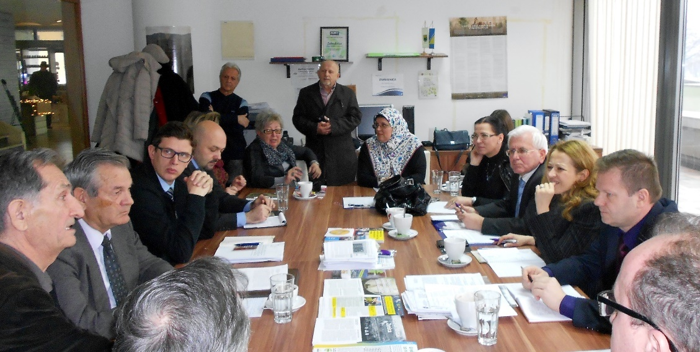
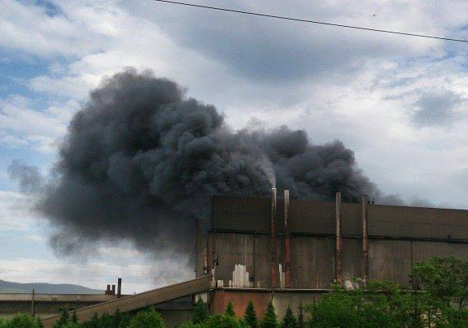
Request for the "integral" permit
Following the joint meeting (Eko forum, City and Canton authorities, Federal inspection, Federal ministry, Prosecutor, ArcelorMittal), the company requested joint permit for the entire factory.
The ministry calls it "integral permit", but it lacks the waste management, and the water permit is issued by different authority.
Expertise requested from US Embassy
Large environmeental projects on hold
"until the permit is renewed"

Slide 8
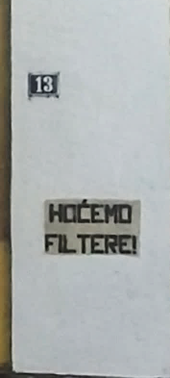
CSO assisted permit renewal process
Unlike any other country in the world, the federal ministry asked CSO to participate in permitting process
Eko forum and the local community suggested experts to assess the request for permit renewal
Expert team: 2 from the ministry, 1 from Eko forum, 1 from the City and 1 from the local communities
Expert team performed the field visit, assessed the documentation, wrote the report with suggestions – 3 times?!?
The final meeting had 3 different minutes
Permit issued in April 2017
Industrial waste depot still operates without permit

Slide 9
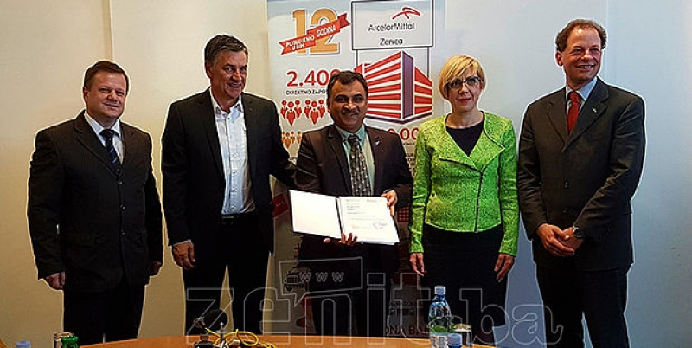
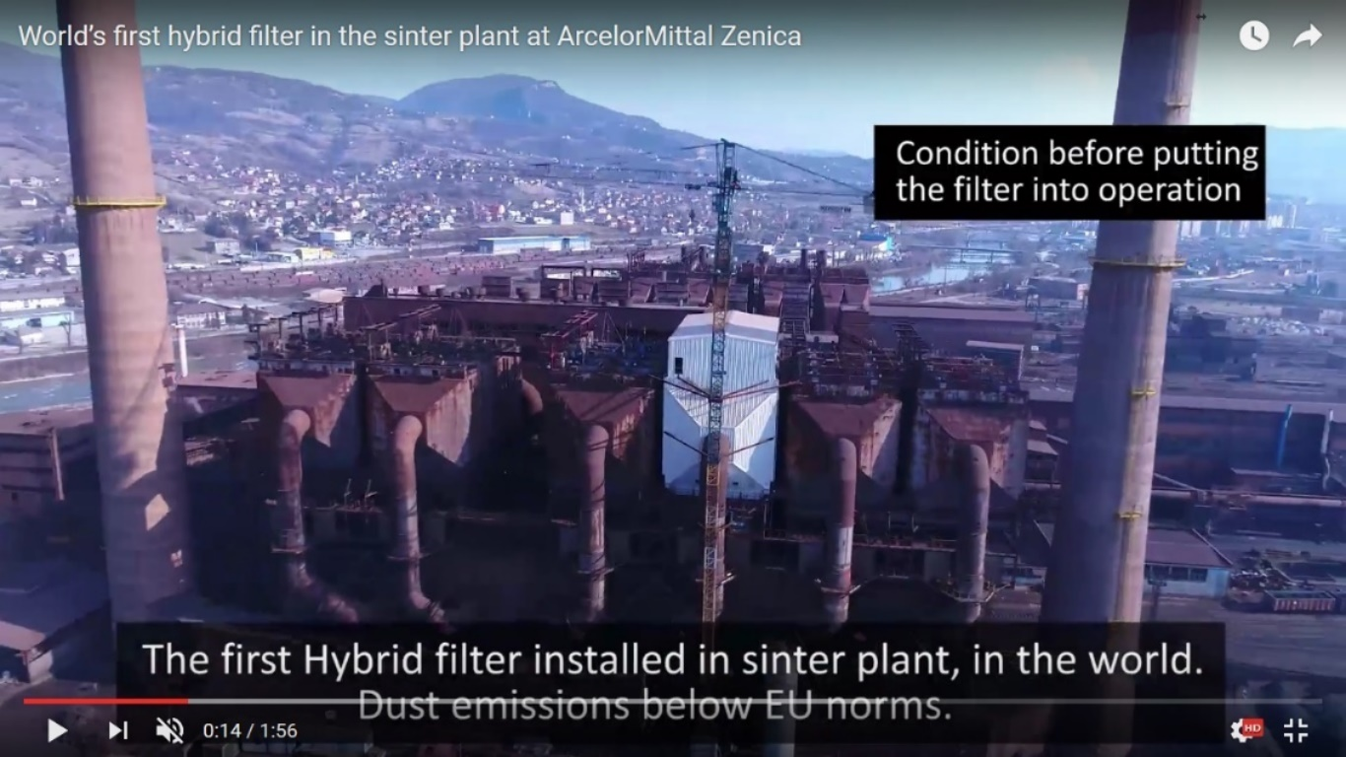
The struggle never ends
Local, Cantonal, Federal, National authorities
Inspection
Health authorities and institutions
Cantonal and Federal Parliament
ArcelorMittal
Foreign embassies
International media (BBC, Guardian)
National and international NGO's
Local and international experts
International financial institutions

Slide 10
