Slide 1
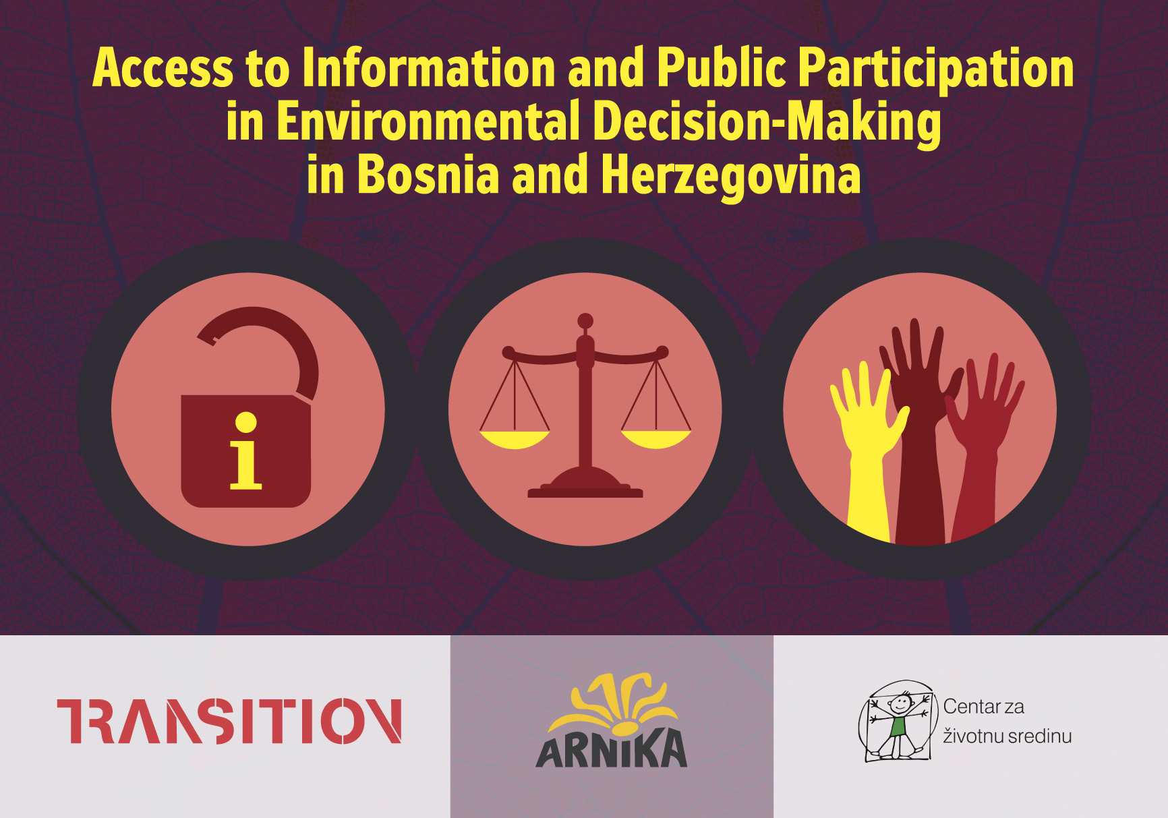

Slide 2
BACKROUND
Author and editor: Sarka Havrankova
Contributors: Viktor Bjelić, Vanja Junuzović, Ratko Pilipović, Jelena Brkić, Zuzana Vachůnová, Martin Skalský
Prepared with the support of the Ministry of Foreign Affairs of the Czech Republic within the framework of the Transition Promotion Programm
The guideline is intended primarily for civil society organizations and activists, environmental and civil rights lawyers, policy analysts, and other non-governmental actors in Bosnia and Herzegovina

Slide 3
What you find there
The guideline describes legislation and processes related to environmental protection and public participation in decision-making and identifies its weaknesses.
We focus on the key rights of reflected in Aarhus convention:
to access environmental information,
to participate in environmental decision-making,
to access justice
It walks you through relevant steps of environmental decision-making and administrative processes and provides an overview of procedural requirements and obligations of public authorities.
spatial planning
process of environmental impact assessment
environmental and construction permit

Slide 4
SECTIONS
Legislation
Processes
Lawmaking
Cases
Competencies

Slide 5
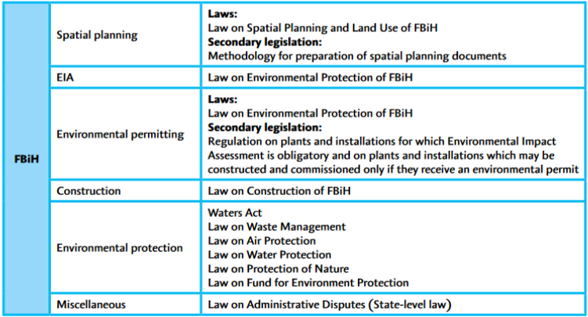
Legislation
Regulation of Spatial Planning, EIA, Environmental and Construction Permitting Process

Slide 6
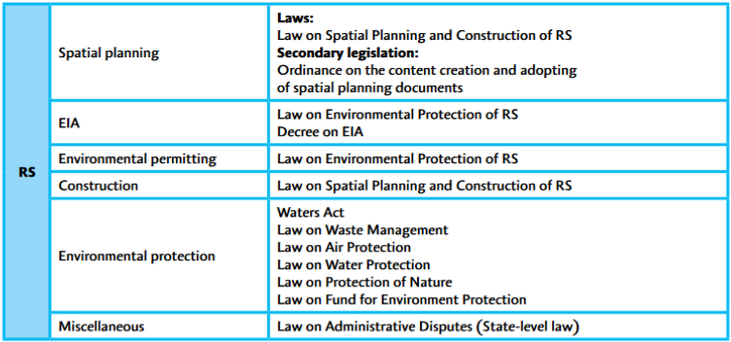
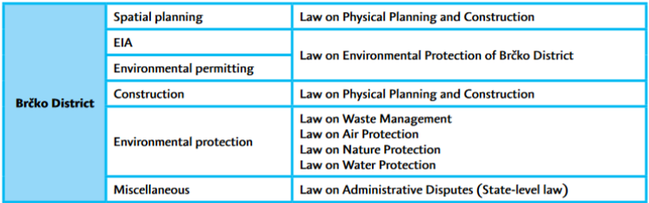

Slide 7
Legislation
Implementation of EU Environmental Directives
As a potential candidate for EU membership, BiH is obliged to harmonize its legislation with the EU legal framework and to transpose several EU directives in its legislation. We describe the most relevant EU directives related to the environmental decision-making and administrative processes:
IPPC Directive
Industrial Emissions Directive
EIA Directive
SEA Directive
Environmental Information Directive
Public Participation Directive

Slide 8
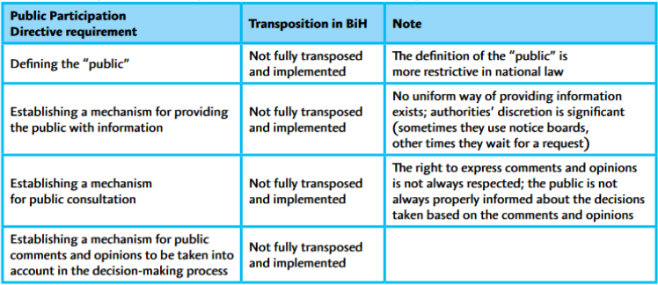

Slide 9
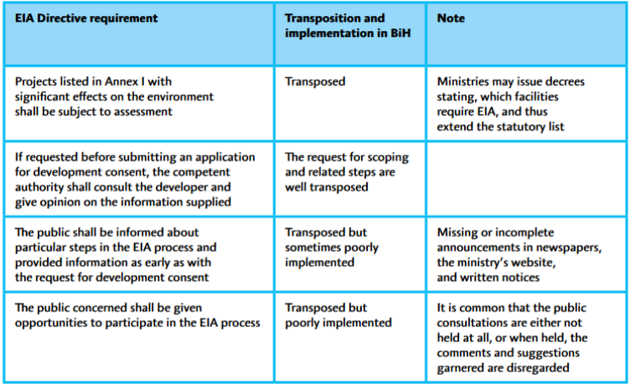

Slide 10
Legislation
Access to Information and Public Participation in Environmental Decision-making
Description of BiH’s obligations related to providing access to environmental information and the right to participate in environmental decision-making. These obligations ensue from:
International legal instruments governing environmental protection and pollution prevention: Aarhus and Espoo Conventions and Kyiv Protocol
EU law: Industrial Emissions, Environmental Information and Public Participation Directives
National law: the Law on Freedom of Access to Information

Slide 11
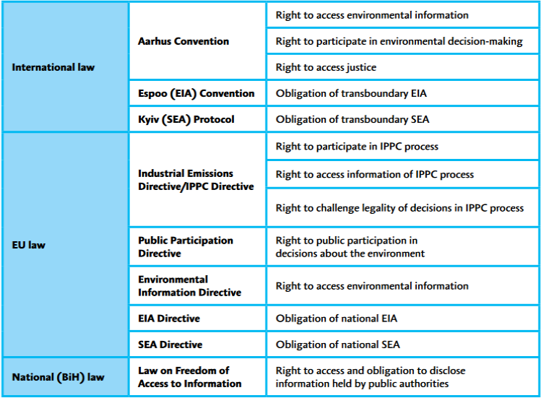

Slide 12
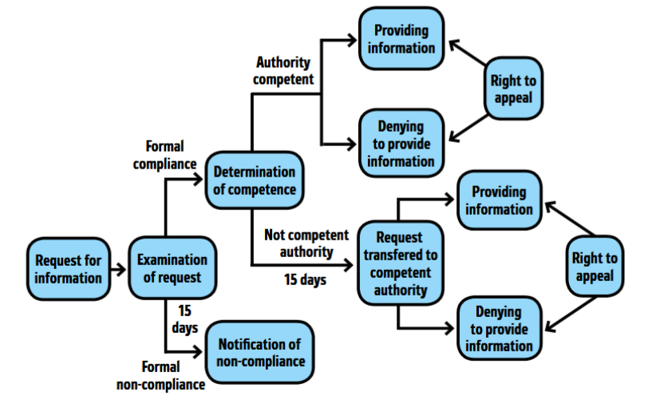

Slide 13
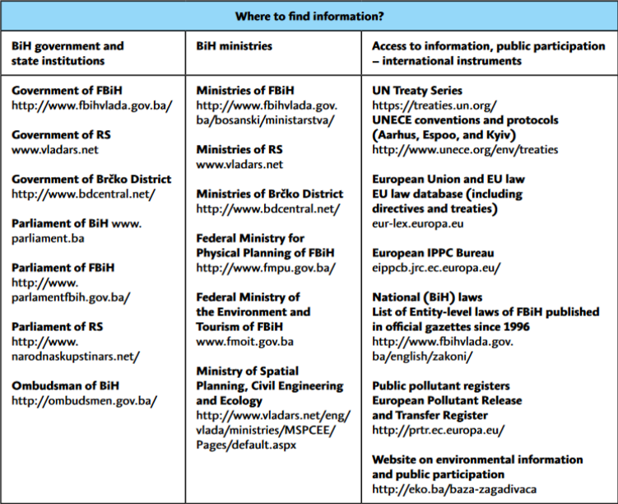

Slide 14
Competencies
Authorities involved in EIA process
Authorities involved in Environmental Permitting Process
Authorities involved in Spatial Planning and Construction

Slide 15
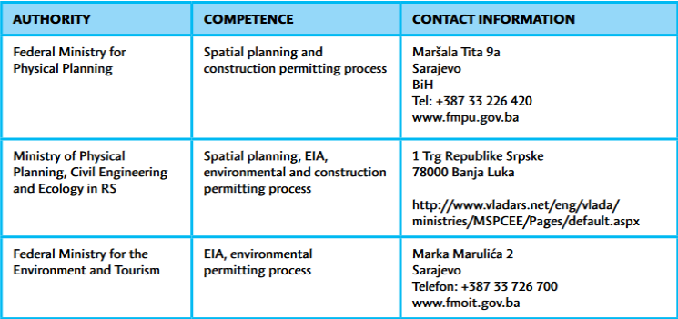
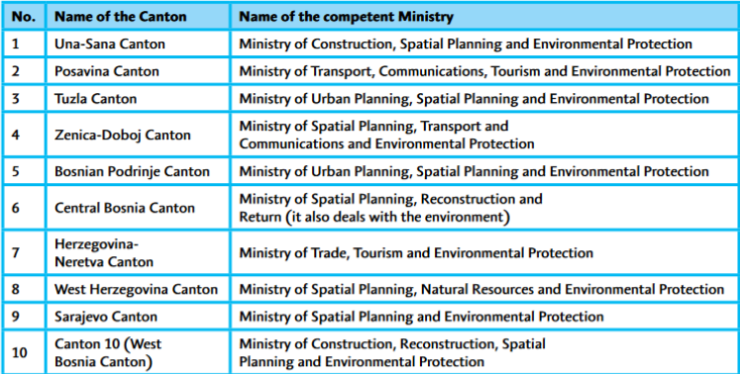

Slide 16
Processes
Desription of processes open for public participation including statutory deadlines and legal remedies.
Spatil planning in FBiH, RS and Brčko District
EIA process
Environmental permitting process
Construction permitting process in FBiH, RS and Brčko District

Slide 17
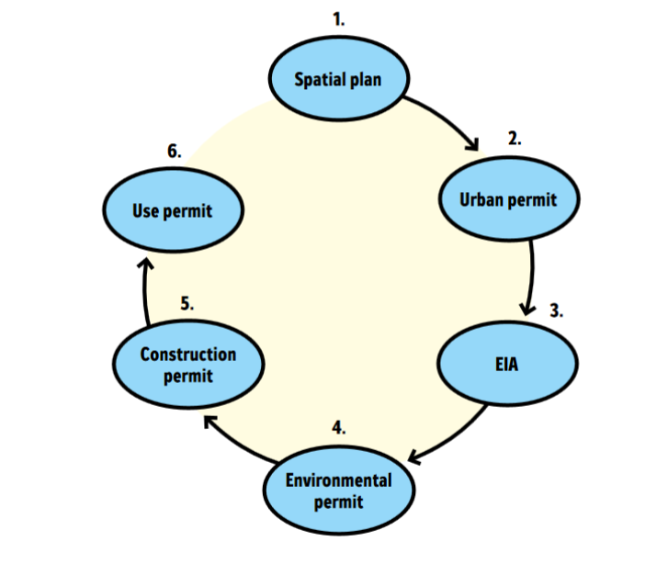

Slide 18
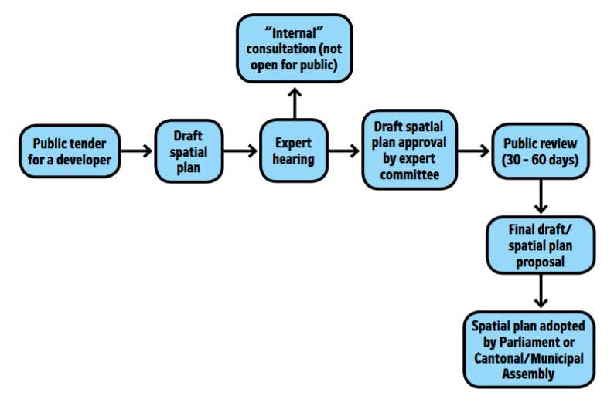

Slide 19
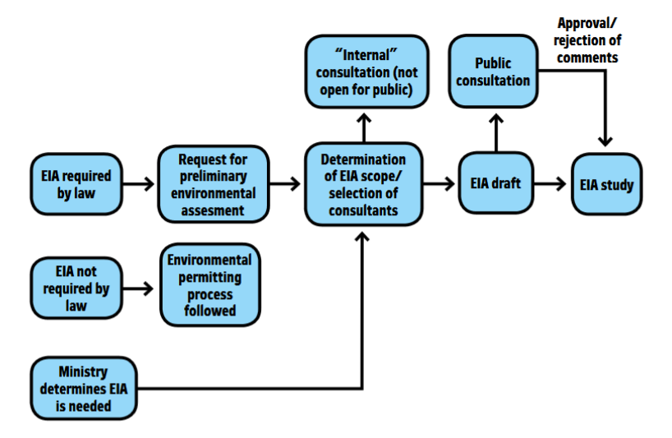

Slide 20
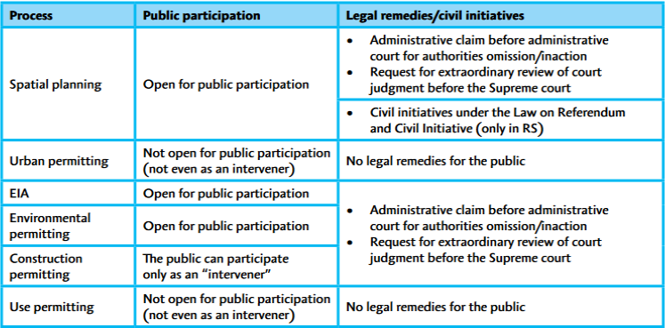

Slide 21
Lawmaking
The public has also the right to participate in legislative and policy-making processes.
Legislative Process in the State of BiH
Legislative Process in the Entities

Slide 22
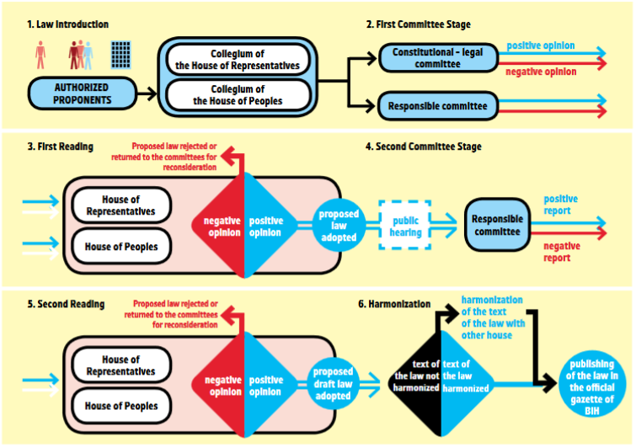

Slide 23
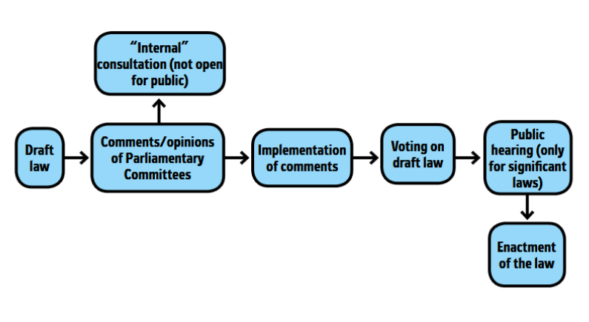

Slide 24
More information
www.eko.ba
www.english.arnika.org
www.czzs.org
www.aarhus.ba
People who will decide to actively deal with local environmental issues and will have specific questions, can contact Aarhus centre of Centre for Environment:
vanja.junuzovic@czzs.org
+387(0)51 433 141,

Slide 25
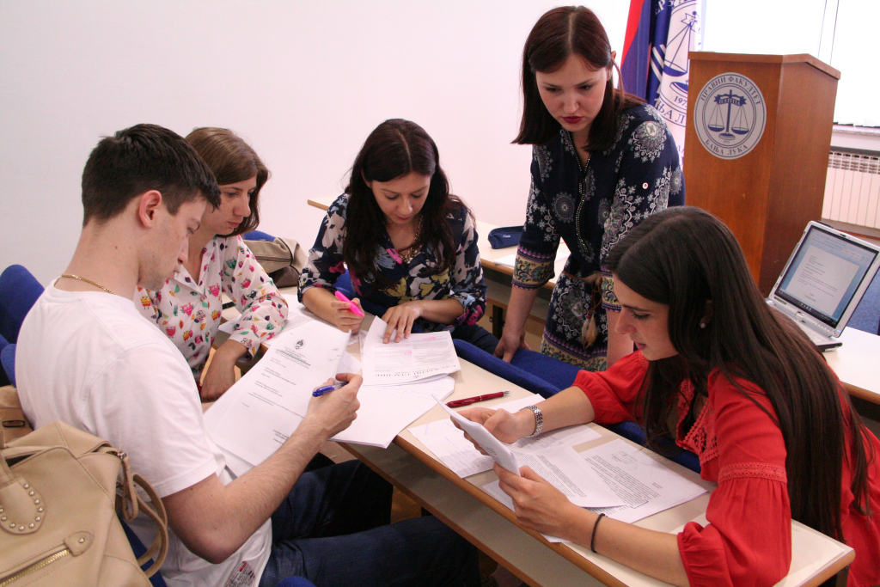
THANK YOU
FOR ATTENTION

